Slide 1


ARL internship program - 2022
DON BOSCO INSTITUTE OF TECHNOLOGY
Department of Computer Science & Engineering
AI BASED GAMING ENGINE
INTERNSHIP GROUP – MEMBERS:
AMOD KUMAR JHA(1DB19CS009)
CHETHAN S(1DB19CS035)
GURUPRASAD S R(1DB19CS056)
EXTERNAL GUIDE:
MR. RAGHAVENDRA SWAMY H
AUTOMATA RESEARCH LABORATORIES
INTERNAL GUIDE:
DR. VENUGEETHA Y
PROFESSOR AT DBIT

Slide 2
AGENDA
Area of Internship | Slide 3 | Algorithm, Flowchart & Pseudo code of the game | Slide 13
Introduction | Slide 4 | Algorithm, Flowchart & Pseudo code of the warrior(Player 1) | Slide 17
AI based Gaming engine | Slide 5 | Algorithm, Flowchart & Pseudo code of the wizard(Player 2) | Slide 21
Title of the game | Slide 7 | Screenshots of the game | Slide 25
Storyline | Slide 8 | Internship activity | Slide 32
Character and background features | Slide 9 | Key takeaways of the Internship | Slide 33
Gameplay | Slide 12 | Reference | Slide 34

Slide 3

AI- BASED GAMING ENGINE
AREA OF INTERNSHIP

Slide 4

INTRODUCTION
Artificial intelligence is the simulation of human intelligence processes by machines, especially computer systems. Specific applications of AI include expert systems, natural language processing, speech recognition and machine vision. The main characteristics of AI are autonomy and adaptively.
Branches of AI:-
There are a few major branches of AI:
Machine learning (ML)
Robotics
Expert systems
Natural language processing (NLP)
Neural network

Slide 5
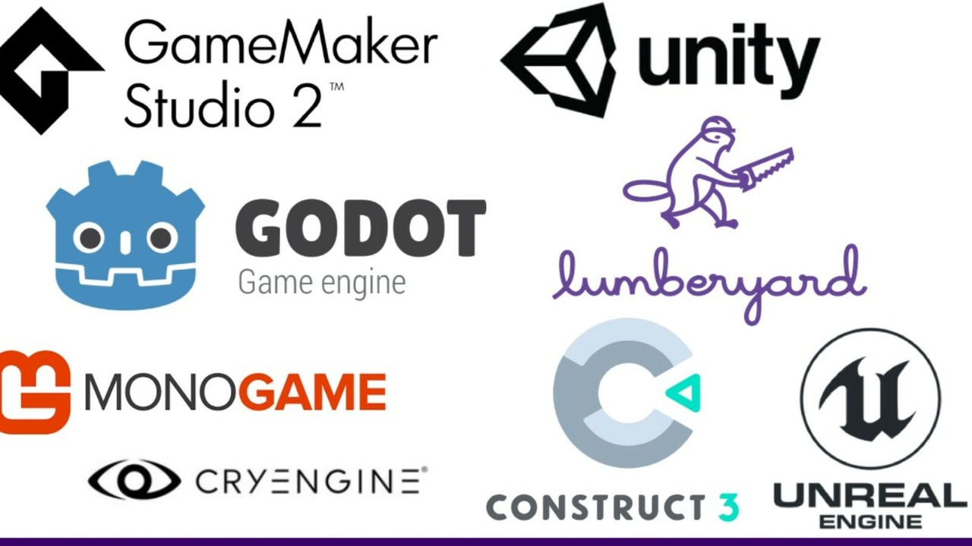
AI BASED GAMING ENGINE
A Game Engine is defined as being a set of software tools or API’s built to optimize the development of a video game. This will typically include a game loop or at the very least a 2D or 3D rendering engine.
One of the feature of gaming engine may include
Artificial Intelligence.
We can implement or generate responsive, adaptive
and also intelligent behaviors which is similar to human-like
intelligence which can be included in the video games
which uses Artificial Intelligence(AI).
Examples: Unreal engine, Unity,
Open3D Amazon game engine, CryEngine, Panda 3D

Slide 6

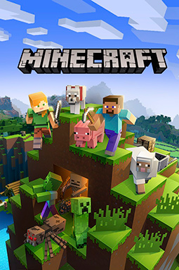


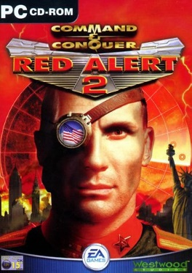
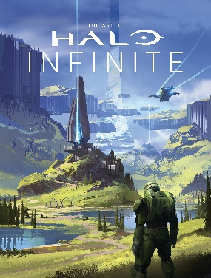
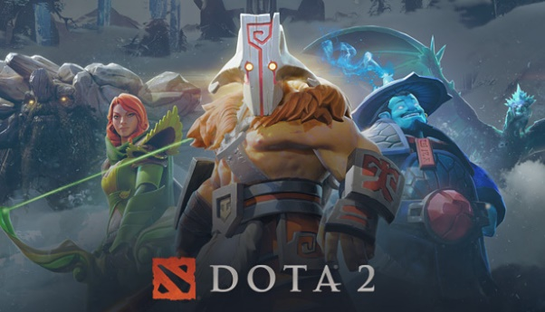
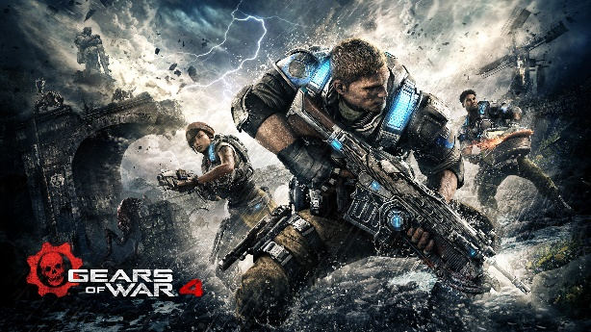
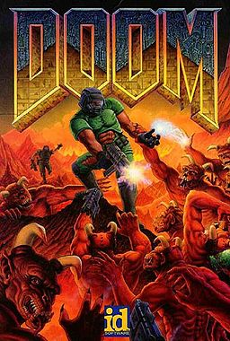
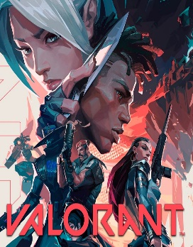

Few Games of different genre
Sandbox
E.g.: Minecraft, Grand Theft Auto, The Sims
Real-time strategy (RTS)
Warcraft, Age of Empires, Command and Conquer
Shooters (FPS and TPS)
Halo, DOOM, Gear of War
Multiplayer online battle arena (MOBA)
Dota 2, Valorant, League of Legends

Slide 7

TITLE OF THE GAME
STICKMAN FIGHT

Slide 8
GAMEPLAY
The game begins with the 2 players opposite to each other and face each and begins the battle.
Each player has it’s own health bar and when the attack is being used against each other then the health starts decreasing and when the health bar has reached 0 then the particular player wins.
The game is played again and again as much as the player wants and whomever wins get a VICTORY screen.
Each time the attack is be made by one of the player the health bar is reduced by 20 out of 100 and VICTORY will be displayed when the health bar reaches 0.

Slide 9
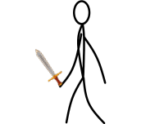

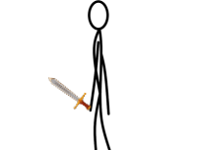
WARRIOR – Player1
One of the player is a stickman which can walk around in the screen and also jump around and when the particular key is pressed the Warrior can attack. The warrior can be controlled by using the W,A,D keys for movement and also we can use the space button to jump. We can control the attack by using R.

Slide 10
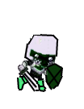
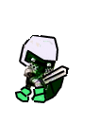

WIZARD – Player2
One of the player is a wizard which can walk around in the screen just like the Player1 and also jump around and when the particular key is pressed the Wizard can attack. The wizard can be controlled by using the arrow( right ,left ,up ) keys for movement and also we can use the space button to jump. We can control the attack by using NUM1.

Slide 11
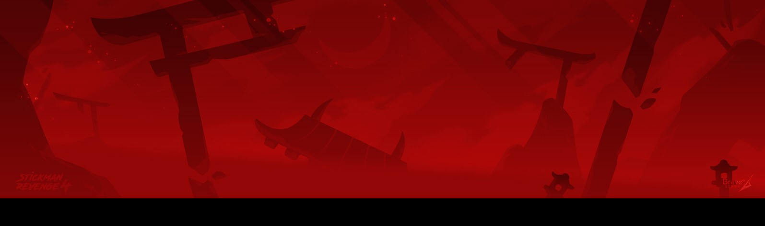
BACKGROUND
The background of the game is set in a place of temple region and also with a red background and a black platform to play the game. The Warrior is towards the left side of the screen and the Wizard is towards the right side of the screen.

Slide 12
ALGORITHM OF THE GAME
STEP 1 : Start
STEP 2 : Initialize background
STEP 3 : Initialize Warrior
STEP 4 : Initialize Wizard
STEP 5 : Initialize the Health Bars and the weapons
STEP 6 : While warrior or wizard is Alive, do Steps 7, 8.

Slide 13
ALGORITHM OF THE GAME(CONTD)
STEP 7 : Get user input to control the Warrior movement.
STEP 8 : Get user input to control the Wizard movement.
STEP 9 : If Warrior dies :
Print “WIZARD VICTORY”
STEP 10 : If Wizard dies :
Print “WARRIOR VICTORY”
STEP 11 : END

Slide 14
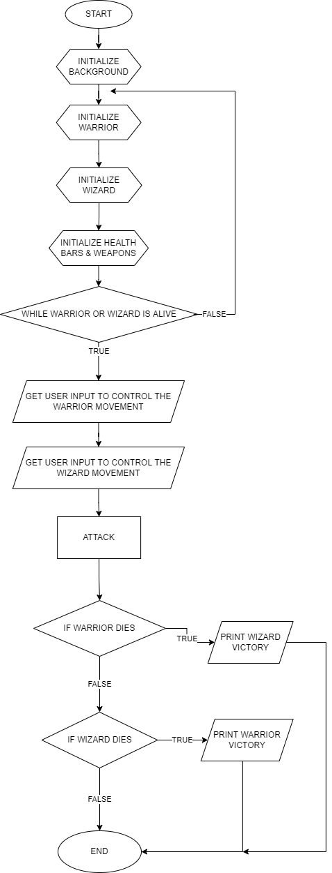
FLOWCHART OF THE GAME

Slide 15
PSEUDO CODE OF THE GAME
While run:
Draw_BG()
Draw_Warrior()
Draw_Wizard()
Draw_health bar()
WHILE Warrior or Wizard is ALIVE:
Get_Warrior_input()
Get_Wizard_input()
continue
If Warrior_Health_bar ==0:
Print(“WIZARD VICTORY”)
If Wizard_Health_bar==0:
Print(“WARRIOR VICTORY”)

Slide 16
ALGORITHM OF THE WARRIOR(PLAYER1)
STEP 1 : Start
STEP 2 : If health bar of warrior == 0
return wizard victory
else
continue
STEP 3 : Get_Warrior_Input:
If Warrior _Input ==W:
JUMP()
Elif Warrior _Input ==A:
MOVE_LEFT()
Elif Warrior r_Input == D:
MOVE_RIGHT()
Elif Warrior _Input = = E:
ATTACK()

Slide 17
ALGORITHM OF THE WARRIOR(PLAYER1) CONTD
STEP 4 : If WIZARD.ATTACK.COLLIDERECT(WARRIOR.RECT):
Warrior_Health_bar - = 20
else
CONTINUE
STEP 5 : return

Slide 18
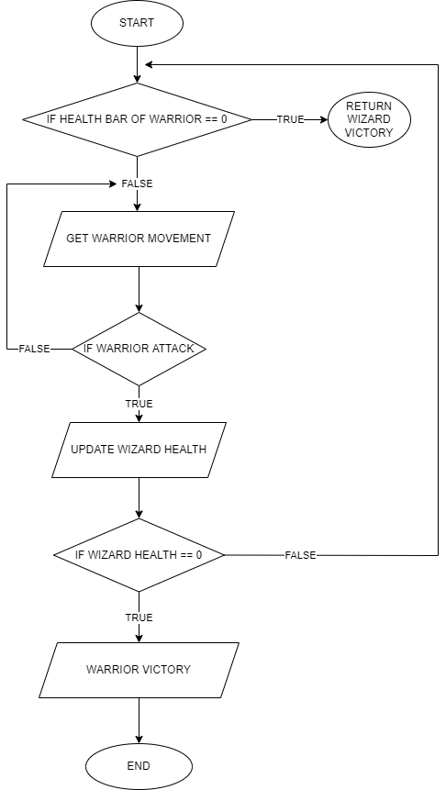
FLOWCHART OF THE WARRIOR

Slide 19
PSEUDO CODE OF THE WARRIOR(PLAYER1)
Warrior ()
While Warrior_Health_bar!= zero:
I=Get_User_Input()
If(i==W)
JUMP()
Elif(I==A)
MOVE_RIGHT()
Elif(I==D)
MOVE_LEFT()
Elif(I==E)
ATTACK()
If WIZARD.ATTACK.COLLIDERECT(WARRIOR.RECT):
Warrior_Health_Bar-=20
Else
Continue
Return

Slide 20
ALGORITHM OF THE WIZARD(PLAYER2)
STEP 1 : Start
STEP 2 : If health bar of wizard == 0
return warrior victory
else
continue
STEP 3 : Get_ wizard _Input:
If wizard _Input ==UP_ARROW_KEY:
JUMP()
Elif wizard _Input ==LEFT_ARROW_KEY:
MOVE_LEFT()
Elif wizard _Input == RIGHT_ARROW_KEY:
MOVE_RIGHT()
Elif wizard _Input==NUM1:
ATTACK()

Slide 21
ALGORITHM OF THE WIZARD(PLAYER2) CONTD
STEP 4 : If WARRIOR.ATTACK.COLLIDERECT(WIZARD.RECT):
Wizard_Health_bar -=20
Else
Continue
STEP 5 : Return

Slide 22
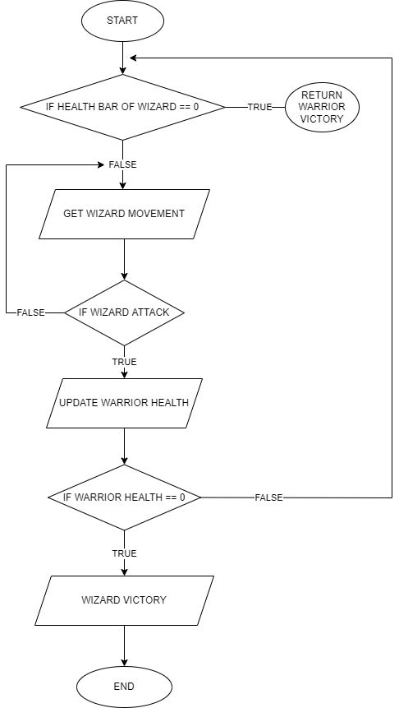
FLOWCHART OF THE WIZARD

Slide 23
PSEUDO CODE OF THE WIZARD(PLAYER2)
Wizard ()
While Wizard_Health_bar!= zero:
I=Get_User_Input()
If(i==UP_ARROW_KEY)
JUMP()
Elif(I==LEFT_ARROW_KEY)
MOVE_RIGHT()
Elif(I==RIGHT_ARROW_KEY)
MOVE_LEFT()
Elif(I==NUM1)
ATTACK()
If WARRIOR.ATTACK.COLLIDERECT(WIZARD.RECT):
Wizard_Health_Bar-=20
Else
Continue
Return

Slide 24
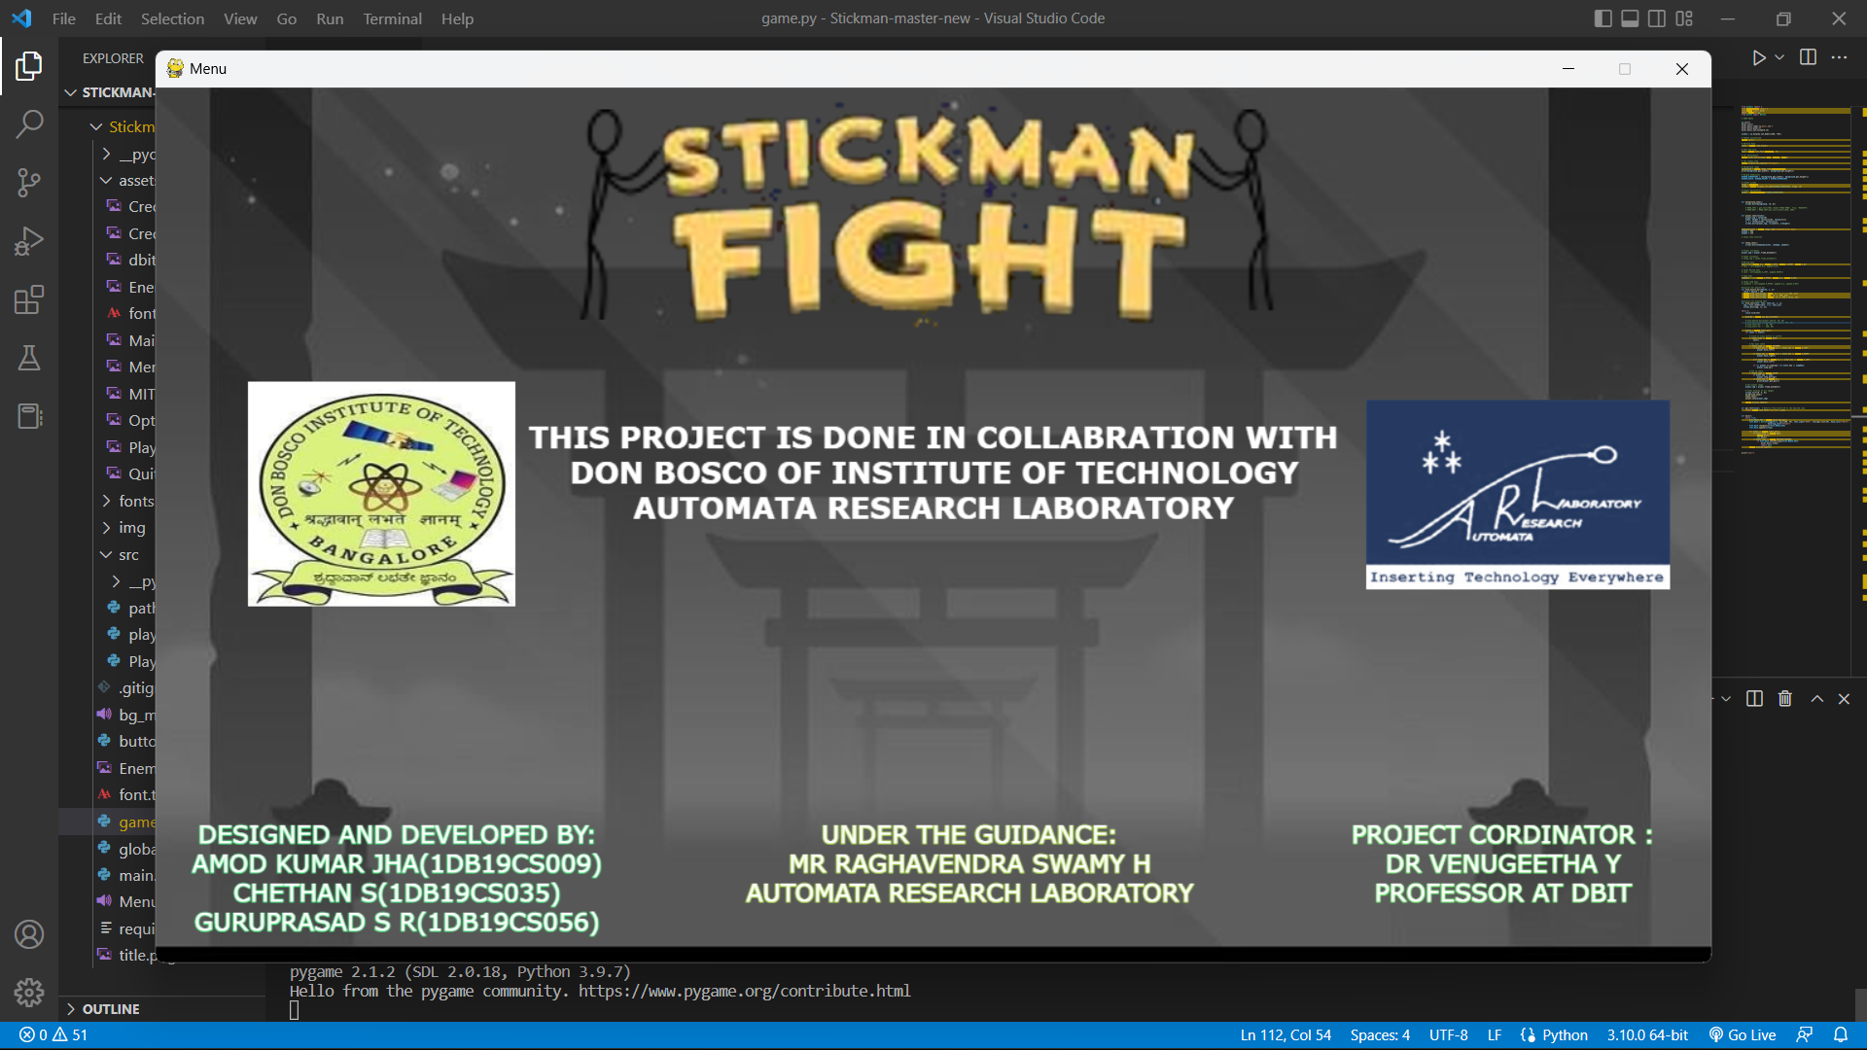
SCREENSHOT OF THE GAME

Slide 25
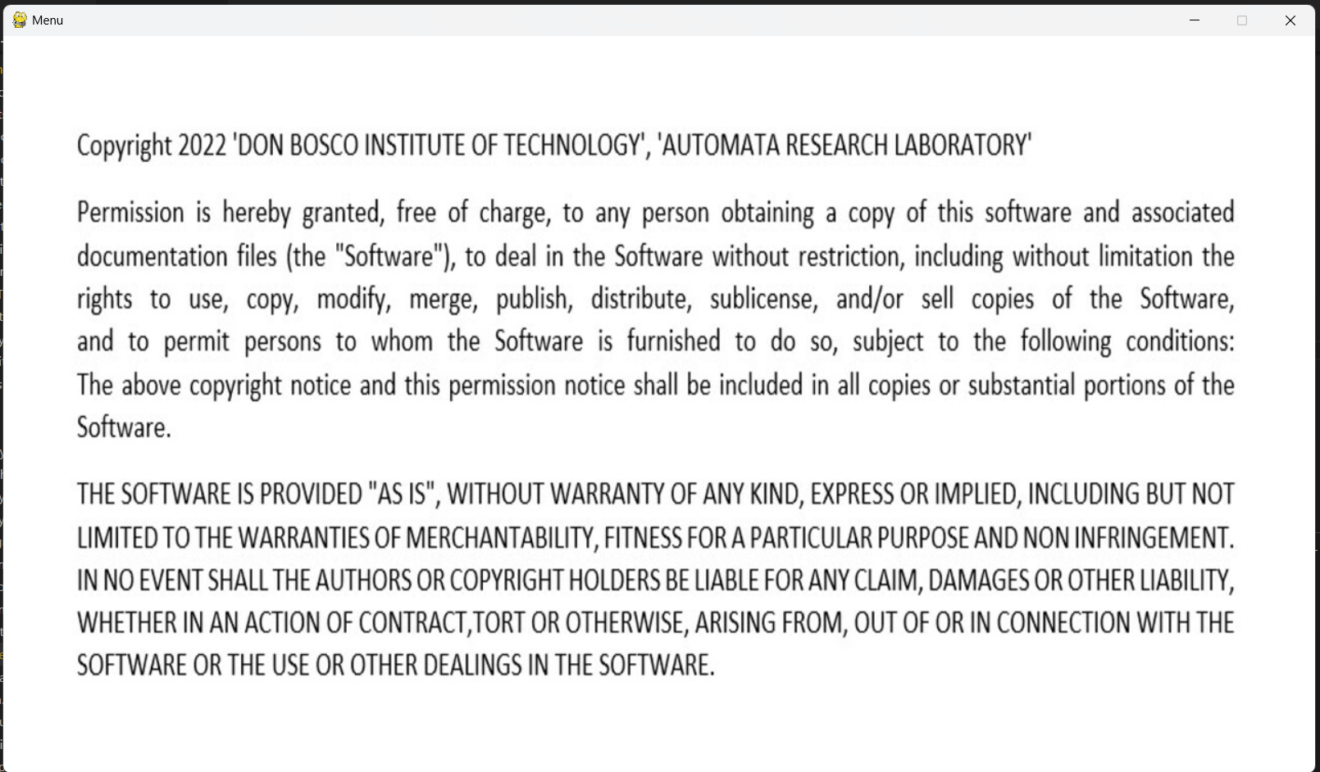
SCREENSHOT OF THE GAME

Slide 26
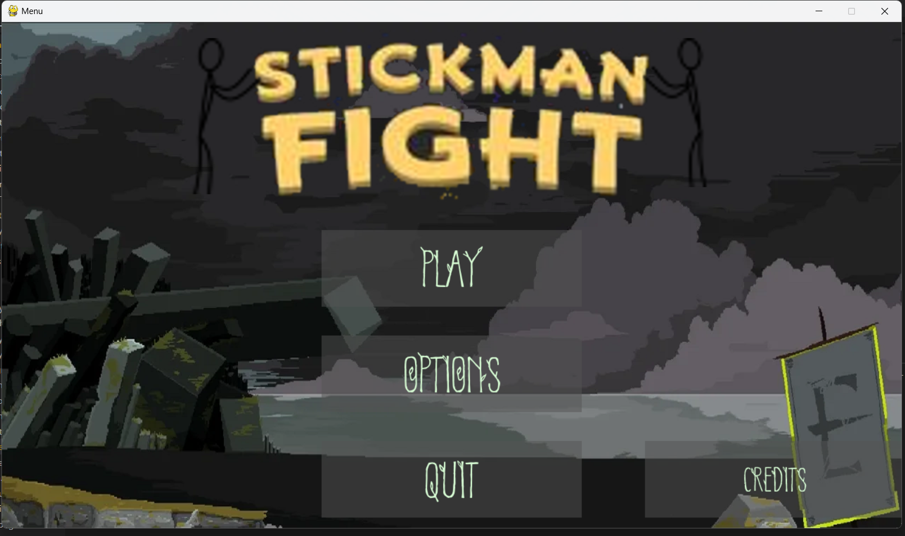
SCREENSHOT OF THE GAME

Slide 27
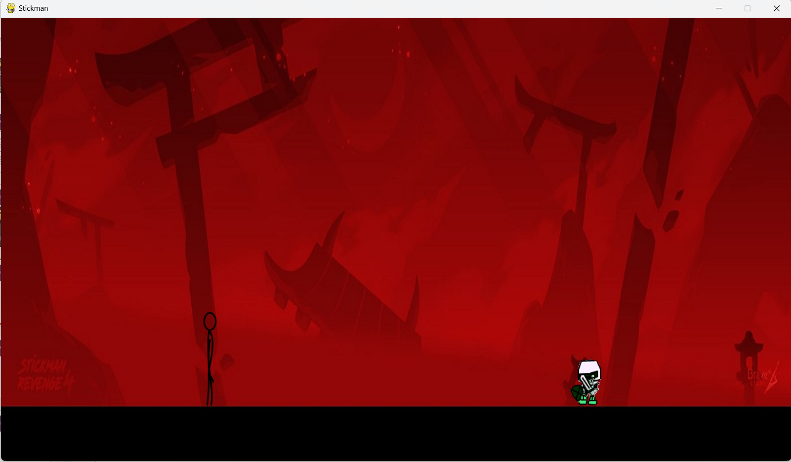
SCREENSHOT OF THE GAME

Slide 28
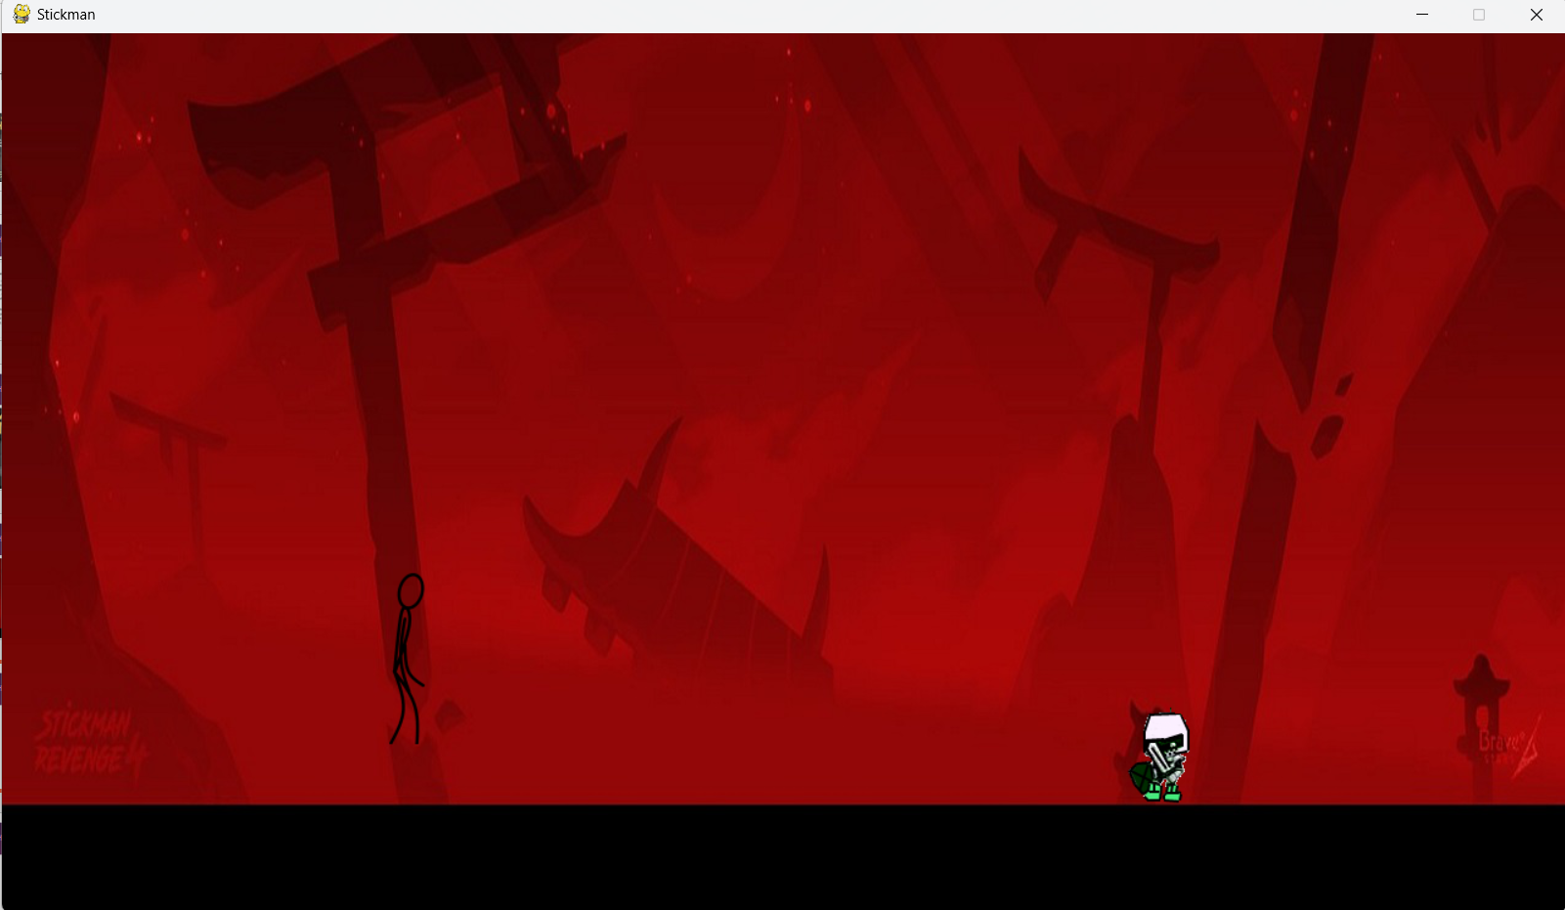
SCREENSHOT OF THE GAME

Slide 29
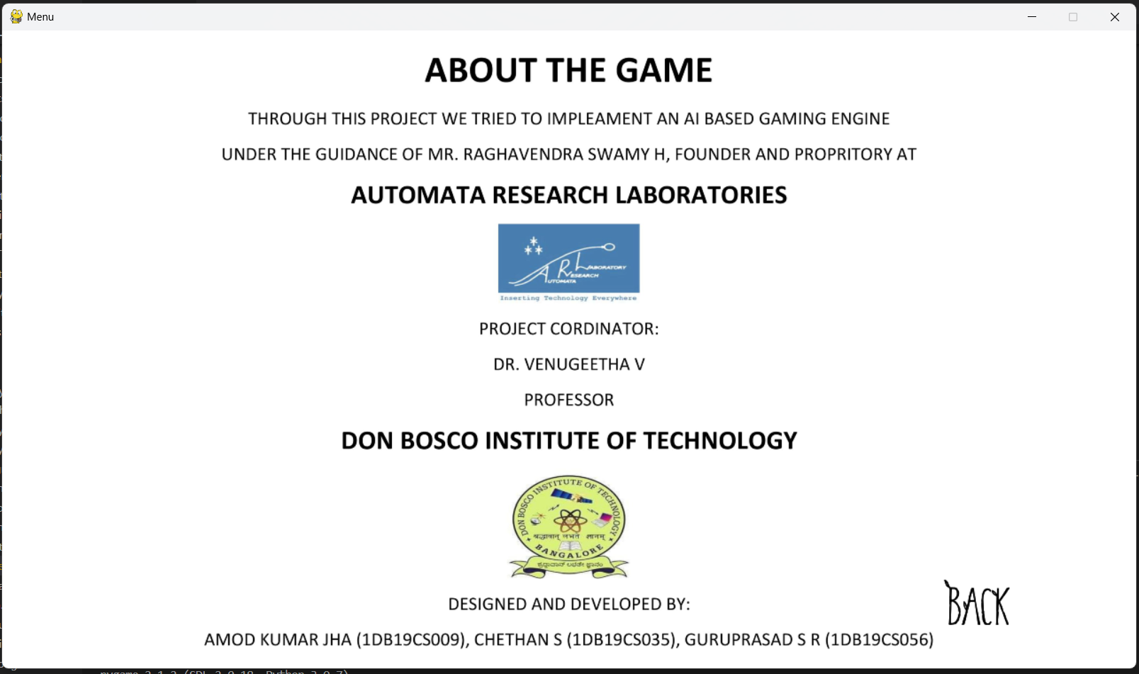
SCREENSHOT OF THE GAME

Slide 30
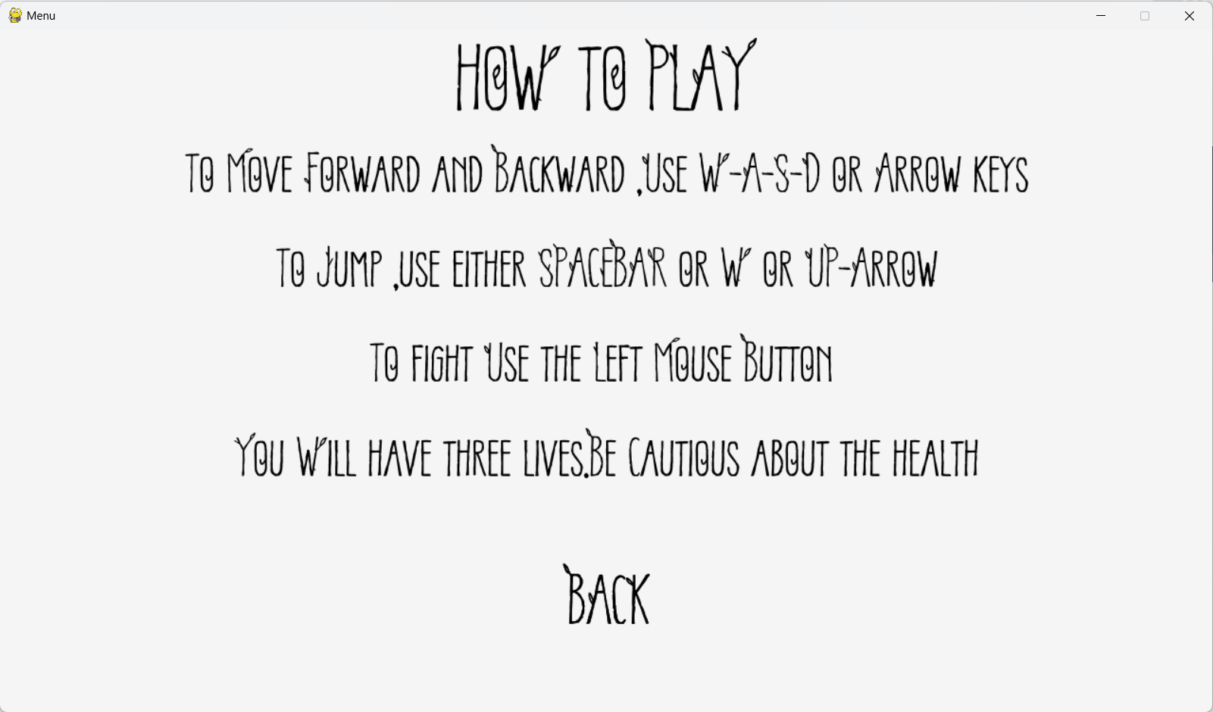
SCREENSHOT OF THE GAME

Slide 31
INTERNSHIP ACTIVITY
One of the task in the internship activity was to watch the movie “The Intern", which was released on 25th September, 2015.
Learning points in the movie:-
Choose a Caring Mindset
The immense love & passion for work
Avoid prejudices
No matter how you feel , get up , dress up , show up & never give up

Slide 32
KEY TAKEAWAYS OF THE INTERNSHIP
Learnt about Project development life cycle and all the components that go into developing a full fledged product.
Learnt about team management, and everything that it takes to make a successful team project.
Learnt about core concepts in game development like pygame and other python supported libraries.
Learnt about the significance of Artificial Intelligence in the gaming industry
Learnt about effective communication among the team members, which is significant in bringing out and implementing ideas related to project.

Slide 33
REFERENCE
Installation of Python IDE - https://www.python.org/downloads/
Installation of PyCharm - https://www.jetbrains.com/pycharm/download/
Pygame package - https://www.pygame.org/
https://analyticsindiamag.com/top-9-python-frameworks-for-game-development/
https://pygame-ai.readthedocs.io/en/latest/index.html
YouTube - https://youtu.be/s5bd9KMSSW4
https://opensource.org/licenses/MIT
https://www.synopsys.com/blogs/software-security/5-types-of-software-licenses-you-need-to-understand/

Slide 34
THANK
YOU

